Slide 1



Fine-Tuning Representation
Models for Classification
Chapter 11

Slide 2


Effect of frozen encoder blocks
The effect of freezing certain encoder blocks on the performance of the
model. Training more blocks leads to improved performance but stabilizes early on.

Slide 3
Few-Shot Classification
In few-shot classification, we only use a few labeled data points to learn from.
Notes:
Few-shot classification is a technique within supervised classification where you have a classifier learn target labels based on only a few labeled examples. This technique is great when you have a classification task but do not have many labeled data points readily available. In other words, this method allows you to label a few high-quality data points per class on which to train the model.

Slide 4
The three main steps of SetFit.
A higher temperature increases the likelihood that less probable tokens are generated and vice versa.

Slide 5
Continued Pretraining with Masked Language Modeling
To fine-tune the model on a target task—for example, classification—we either start with pretraining a BERT model or use a pretrained one.
Notes:
In the examples thus far, we leveraged a pretrained model and fine-tuned it to perform classification. This process describes a two-step process: first pretraining a
model (which was already done for us) and then fine-tuning it for a particular task.

Slide 6
Continue pretrained
Instead of a two-step approach, we can add another step that continues to pretrain the pretrained model before fine-tuning it on the target task. Notice how the masks were filled with abstract concepts in 1 while they were filled with movie-specific concepts in 2.

Slide 7
Pretrained use cases:
The three-step approach illustrated for specific use cases.

Slide 8
Methods to mask tokens:
Different methods for randomly masking tokens.

Slide 9
NER: Named-Entity Recognition
Fine-tuning a BERT model for NER allows for the detection of named
entities, such as people or locations.

Slide 10










TYPES OF AI
NARROW AI
GENERAL AI
SUPER AI
Narrow AI is designed to perform a specific task
General AI can perform any intellectual task that a human can
Super AI is hypothetical and would surpass human intelligence

Slide 11





HISTORY OF AI
The Dartmouth Conference, where the term "artificial intelligence" was first coined and AI was established as a field of research.
1956
The first AI system that could understand and respond to natural language was created by Terry Winograd, which marked a major step forward in natural language processing.
1974
IBM's Deep Blue defeated the world chess champion Garry Kasparov, demonstrating that machines could surpass human intelligence in specific domains.
1997
The emergence of deep learning led to breakthroughs in computer vision, speech recognition, and natural language processing.
2012

Slide 12



IN FINANCE
75%
12,000
50%
people said that AI has improved their decision-making process.
Morgan Chase used AI to analyze 12,000 commercial loan agreements in seconds
The use of AI in fraud detection has led to a 50% reduction in false positives

Slide 13








IN MANUFACTURING
Item 2
Item 3
12
10
8
6
4
2
0
2015
2016
2017
2018
2019
2020
2021

Slide 14








IN TRANSPORTATION
REDUCE 20% FUEL CONSUMPTION
REDUCE 30% MAINTENANCE COSTS
Self-driving trucks powered by AI have been shown to reduce fuel consumption by up to 20%, saving companies thousands of dollars per year.
AI-powered predictive maintenance can reduce maintenance costs by up to 30%, and increase vehicle reliability and uptime.

Slide 15






03
SOCIAL IMPLICATIONS
Explores the broader impact of AI beyond specific industries or applications. Considers ethical and societal implications such as job displacement, bias, privacy concerns, and potential impacts on democracy and human rights. Encourages a critical and thoughtful approach to AI development and deployment, taking into account the potential risks and benefits to individuals and society as a whole.

Slide 16




AI AND JOBS
JOBS AT HIGH RISK
JOBS AT SIGNIFICANT RISK
14%
32%

Slide 17



AI ETHICS
81%
People believe that companies should prioritize ethical considerations
63%
Were concerned about the ethical implications of the AI system

Slide 18
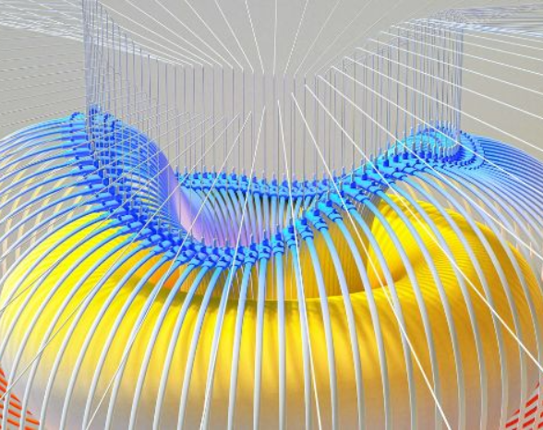

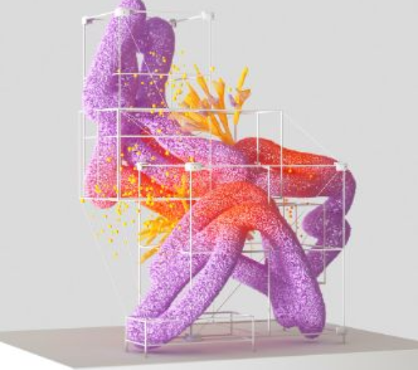

AI AND PRIVACY
A survey by Pew Research Center found that 64% of Americans are concerned about the way that companies are using their data, and 81% feel that they have little or no control over the data that companies collect about them.
20%
55%
The EU's GDPR includes provisions for ensuring that individuals have the right to access and control their personal data, including data that is processed using AI systems.

Slide 19



AI AND SOCIETY
Discusses the broader societal implications of AI, including its impact on job displacement, inequality, and social norms. This section aims to provide a comprehensive understanding of the ways in which AI is shaping our society and the challenges that need to be addressed.
04

Slide 20


THE RISE OF POWERFUL AI WILL BE EITHER THE BEST OR THE WORST THING EVER TO HAPPEN TO HUMANITY. WE DO NOT YET KNOW WHICH.
STEPHEN HAWKING

Slide 21








THANK YOU FOR
CHOOSING EATEMP
We offer free and high-quality slides templates for your presentations. We appreciate you choosing us and hope our templates have been helpful.
As a new website, we rely on your support to grow, so please help us by sharing our site with your friends and colleagues.
eatemp._
@eatemp
eatempofficial
@eatemp.official

